Slide 1


BASICS OF NUTRITION
Date – 08.09.2019
Venue – Hotel Empires,
Bhubaneswar

Slide 2
Good Nutrition
  A child’s survival, growth and development depends upon the quality of care as well as child’s health and nutritional status
  Three conditions are essential for good nutrition
Adequate
Food
Adequate
Care
Protection from
frequent illness

Slide 3
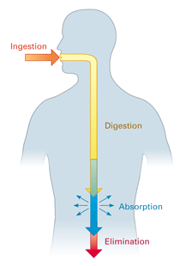
BASIC DEFINITIONS
Food – An edible substance which contains one or more nutrients.
Nutrition – Process of ingestion, digestion, absorption and utilization of food.

Slide 4
BASIC DEFINITIONS
Macro-nutrients – Nutrients required in large quantity. These nutrients are required for providing energy.
Micro-nutrients – Nutrients required in small quantity. These nutrients perform a number of vital functions in the body*.
Essential Nutrients – Nutrients (some amino acids, fatty acids, vitamins, minerals) that cannot be synthesized by the body need to be provided from external sources
Notes:
Micro nutrients: enzymes, catalyst, chemical substances, anti bodies

Slide 5

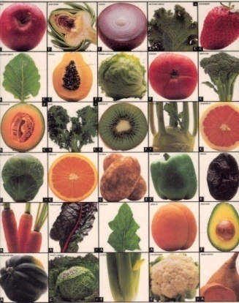

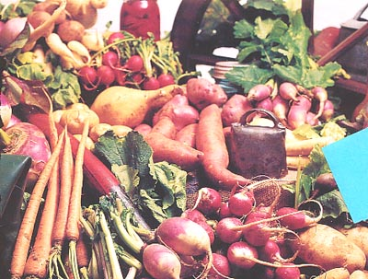


BASIC FUNCTIONS OF FOOD
Energy giving
Protective Foods
Fats, oils, oil seeds, Cereals, roots and tubers and sugar
Vegetables and fruits
Body Building
Pulses, meat, egg, milk and milk products

Slide 6
DEFINITION
Malnutrition- Malnutrition is a general term for a medical condition caused by an improper or insufficient diet.
It refers to undernutrition resulting from inadequate consumption, poor absorption or excessive loss of nutrients, but the term also encompasses over-nutrition, resulting from overeating or excessive intake of specific nutrients

Slide 7
DEFINITION
Undernutrition- Undernutrition happens when people do not get enough food and nutrients to be healthy and to grow at a normal pace. This can happen for at least three reasons:
1) When people simply aren’t getting enough food
2) When people aren’t getting enough of the right kinds of food
3) When people aren’t able to absorb sufficient nutrients into their body (such as when people have diarrhoea or worms)

Slide 8
TYPES OF UNDERNUTRITION
Underweight: Failure to achieve expected weight as compared to a healthy, well-nourished child of the same age is a sign of underweight and is recommended as a basic indicator of the status of a population’s health. This condition can result from either chronic or acute malnutrition or both.
low weight for age (composite measure of acute and chronic malnutrition)

Slide 9
TYPES OF UNDERNUTRITION
Stunting: Stunting, or shortness, is an indicator of chronic (long-term) malnutrition .Failure to achieve expected length/height as compared to a healthy, well-nourished child of the same age is a sign of stunting.
low height for age (indicator of chronic malnutrition)
Wasting: Wasting, or thinness, is an indicator of acute (short-term) malnutrition. low weight for height.

Slide 10
TYPES OF UNDERNUTRITION
Wasting represents a recent failure to receive adequate nutrition, inadequate food intake, incorrect feeding practices, disease, and infection or, more frequently, a combination of these factors.
If a child fails to achieve expected weight for height, that is < -2 SD of the WHO Child Growth Standards median, then we will say the child is suffering from wasting.
Severely wasted child is at 10 times the risk of Death
Micronutrient deficiencies

Slide 11
Intergenerational Cycle of Undernutrition

Slide 12
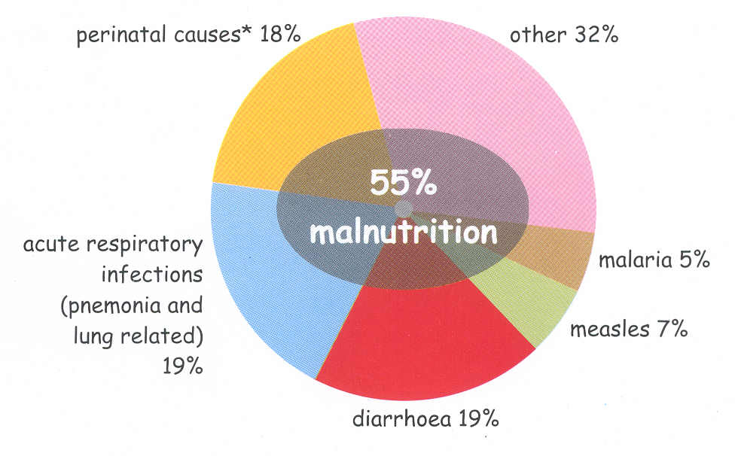
Under Five Mortality –Causes
Source: Black and Caulfield, 2000

Slide 13
Under-5 deaths preventable through universal coverage with individual interventions by Jones et al. LANCET 2003;362:65-71

Slide 14
Undernutrition in ODISHA

Slide 15
Status of Women’s Nutrition
Around half of stunting occurs before birth, and is linked to poor nutrition of women leading to intrauterine growth restriction. Nutritional status of women during pregnancy is in turn influenced by their nutritional status during adolescence, age at marriage and care during pregnancy.

Slide 16
Nearly 30% children start at a disadvantage at birth with LBW; proportion of underweight & stunted children rises from 6 moths onwards plateaus at 24 months : Window of Opportunity: -9 to +24 months
Stunted
Under weight
Wasted
Under nutrition Trends by Age

Slide 18
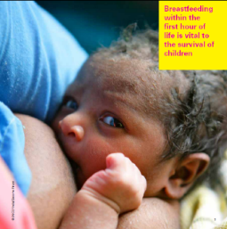
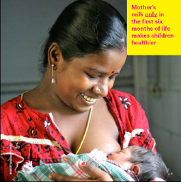
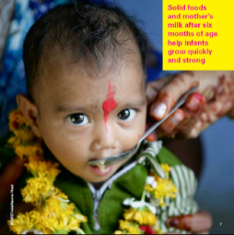
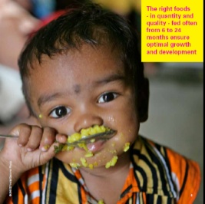
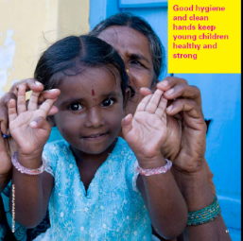
TEN EVIDENCE BASED NUTRITION INTERVENTIONS FOR CHILDREN UNDER TWO AND THEIR MOTHERS:
Early initiation of breast feeding within one hour of birth
Exclusive breast feeding during first six months of life
Timely introduction of complementary foods at six months
Age appropriate foods for children six months to two years of age
Good hygiene and hand washing

Slide 19
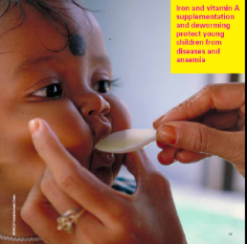
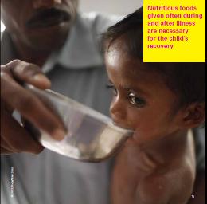
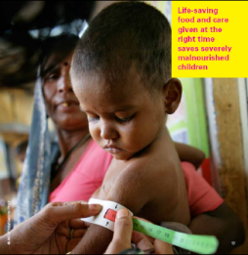
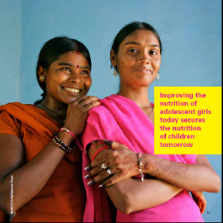
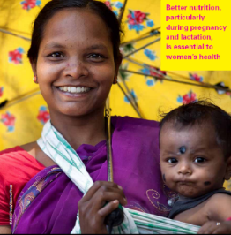
TEN EVIDENCE BASED NUTRITION INTERVENTIONS FOR CHILDREN UNDER TWO AND THEIR MOTHERS:
6. Immunization and bi annual Vitamin A supplementation
with de worming.
7. Appropriate feeding for children during and after illness
8. Therapeutic feeding for children with Severe Acute
Malnutrition
9. Adequate nutrition and support for adolescent girls to prevent anemia
10. Adequate nutrition for women

Slide 20
THANK YOU

